Slide 1
Multiplexing (Muxing)
In telecommunications and computer networks, multiplexing (also known as muxing) is a method by which multiple analog message signals or digital data streams are combined into one signal over a shared medium.

Slide 2
The aim is to share an expensive resource.
Multiplexing originated in telegraphy.
Multiplexing divides the capacity of the high-level communication channel into several low-level logical channels.
A device that performs the multiplexing is called a multiplexer (MUX), & a device that performs the reverse process is called a demultiplexer (DEMUX).

Slide 3
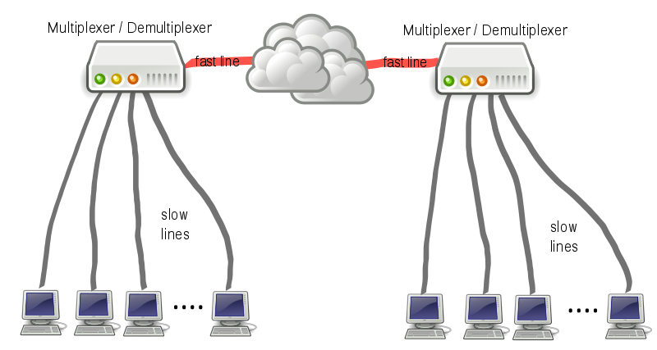
General Idea Behind Multiplexing
General multiplex scheme: the ν input lines-channels are multiplexed into a single fast line. The demultiplexer receives the multiplexed data stream and extracts the original channels to be transferred.

Slide 4
Types of Multiplexing
Frequency Division Multiplexing (FDM)
Time Division Multiplexing (TDM)
Code Division Multiplexing (CDM)
Wave-length Division Multiplexing (WDM)

Slide 5
Frequency Division Multiplexing
Frequency division multiplexing (FDM) means that the total bandwidth available to the system is divided into a series of non-overlapping frequency sub-bands that are then assigned to each communicating source and user pair.

Slide 6
Frquency Division Multiplexing
Frequency-division multiplexing (FDM) is inherently an analog technology.
It achieves the combining of several digital signals into one medium by sending signals in several distinct frequency ranges over that medium.

Slide 7
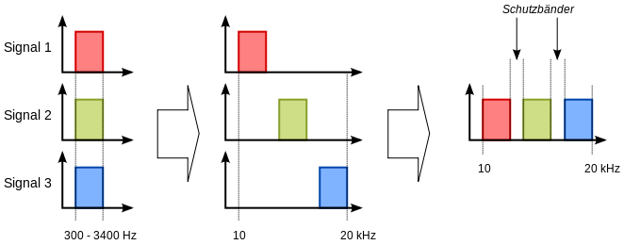
Frequency-division multiplexing (FDM): The spectrums of each input signal
are swifted in several distinct frequency ranges.

Slide 8
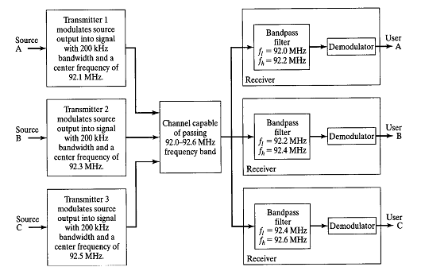
The figure show how this division is accomplished for a case of three sources at one end of a
system that are communicating with three separate users at the other end.

Slide 9
The main advantage is that unlike TDM, FDM is not sensitive to propagation delays.
Channel equalization techniques needed for FDM systems are therefore not as complex as those for TDM systems.
Disadvantages of FDM include the need for bandpass filters, which are relatively expensive & complicated to construct and design.
Another disadvantage of FDM is that in many practical communication systems, the power amplifier in the transmitter has nonlinear characteristics (linear amplifiers are more complex to build), and nonlinear amplification leads to the creation of out-of-band spectral components that may interfere with other FDM channels. Thus, it is necessary to use more complex linear amplifiers in FDM systems.

Slide 10
Time Division Multiplexing
Time-division multiplexing (TDM) is a type of digital (or rarely analog) multiplexing in which two or morebit streams or signals are transferred apparently simultaneously as sub-channels in one communication channel, but are physically taking turns on the channel.

Slide 12
The time domain is divided into several recurrenttime slots of fixed length, one for each sub-channel. A sample byte or data block of sub-channel 1 is transmitted during time slot 1, sub-channel 2 during time slot 2, etc. One TDM frame consists of one time slot per sub-channel plus a synchronization channel and sometimes error correction channel before the synchronization. After the last sub-channel, error correction, and synchronization, the cycle starts all over again with a new frame, starting with the second sample, byte or data block from sub-channel 1, etc.

Slide 13
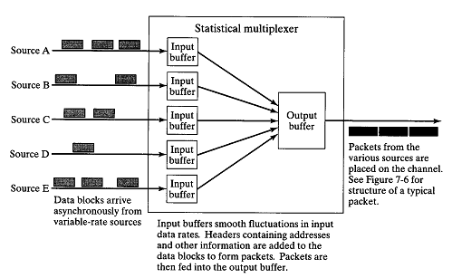

Slide 14
Applications & Examples
The plesiochronous digital hierarchy (PDH) system, also known as the PCM system, for digital transmission of several telephone calls over the same four-wire copper cable (T-carrier or E-carrier) or fiber cable in the circuit switched digital telephone network
The synchronous digital hierarchy (SDH)/synchronous optical networking (SONET) network transmission standards that have replaced PDH.
The RIFF (WAV) audio standard interleaves left and right stereo signals on a per-sample basis
The left-right channel splitting in use for stereoscopic liquid crystal shutter glasses

Slide 15
Code Division Multiplexing
Code division multiple access (CDMA) is a channel access method used by various radio communication technologies. It should not be confused with the mobile phone standards called cdmaOne, CDMA2000 (the3G evolution of cdmaOne) and WCDMA (the 3G standard used by GSM carriers), which are often referred to as simply CDMA, and use CDMA as an underlying channel access method.

Slide 16
One of the concepts in data communication is the idea of allowing several transmitters to send information simultaneously over a single communication channel. This allows several users to share a band of frequencies (see bandwidth). This concept is called multiple access. CDMA employs spread-spectrumtechnology and a special coding scheme (where each transmitter is assigned a code) to allow multiple users to be multiplexed over the same physical channel. By contrast, time division multiple access (TDMA) divides access by time, while frequency-division multiple access (FDMA) divides it by frequency. CDMA is a form ofspread-spectrum signalling, since the modulated coded signal has a much higher data bandwidth than the data being communicated.

Slide 17
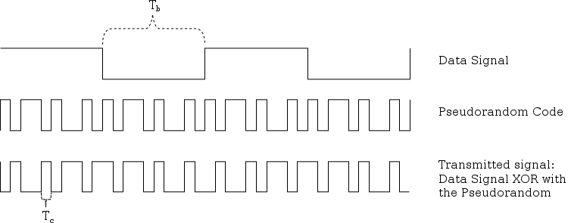

Slide 18
An analogy to the problem of multiple access is a room (channel) in which people wish to talk to each other simultaneously. To avoid confusion, people could take turns speaking (time division), speak at different pitches (frequency division), or speak in different languages (code division). CDMA is analogous to the last example where people speaking the same language can understand each other, but other languages are perceived as noise and rejected. Similarly, in radio CDMA, each group of users is given a shared code. Many codes occupy the same channel, but only users associated with a particular code can communicate.

Slide 19
Uses of CDM
One of the early applications for code division multiplexing is in GPS. This predates and is distinct from its use in mobile phones.
The Qualcomm standard IS-95, marketed as cdmaOne.
The Qualcomm standard IS-2000, known as CDMA2000. This standard is used by several mobile phone companies, including the Globalstar satellite phone network.
The UMTS 3G mobile phone standard, which uses W-CDMA.
CDMA has been used in the OmniTRACS satellite system for transportation logistics.

Slide 20
Wave-Length Division Multiplexing
In fiber-optic communications, wavelength-division multiplexing (WDM) is a technology which multiplexes a number of optical carrier signals onto a single optical fiber by using different wavelengths (i.e colours) of laser light.

Slide 21
This technique enables bidirectional communications over one strand of fiber, as well as multiplication of capacity.
The term wavelength-division multiplexing is commonly applied to an optical carrier (which is typically described by its wavelength), whereas frequency-division multiplexing typically applies to a radio carrier (which is more often described by frequency).
Since wavelength and frequency are tied together through a simple directly inverse relationship, the two terms actually describe the same concept.

Slide 22
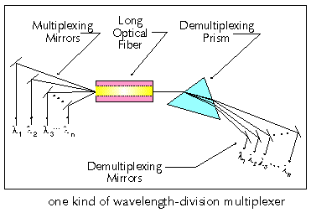

Slide 23
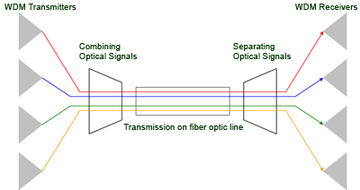

Slide 24
Reference
http://en.wikipedia.org/wiki/Multiplexing
http://zone.ni.com/devzone/cda/ph/p/id/269
http://en.wikipedia.org/wiki/Time-division_multiplexing
http://www.inetdaemon.com/tutorials/telecom/t-carrier/time-division_multiplexing.shtml
http://en.wikipedia.org/wiki/Code_division_multiple_access
http://zone.ni.com/devzone/cda/ph/p/id/268
http://en.wikipedia.org/wiki/Wavelength-division_multiplexing

Slide 25
Thank You

