Slide 1
Modulation Techniques

Slide 2
Introduction
A digital signal is superior to an analog signal because it is more robust to noise and can easily be recovered, corrected and amplified. For this reason, the tendency today is to change an analog signal to digital data. In this section we describe two techniques, pulse code modulation and delta modulation…

Slide 3
Topics discussed in this section:
Pulse Code Modulation (PCM)
Delta Modulation (DM)

Slide 4
Pcm

Slide 5
Introduction to pcm
PCM consists of three steps to digitize an analog signal:
Sampling
Quantization
Binary encoding
Before we sample, we have to filter the signal to limit the maximum frequency of the signal as it affects the sampling rate.
Filtering should ensure that we do not distort the signal, ie remove high frequency components that affect the signal shape.

Slide 6
Pulse code modulation (PCM) is a procedure of converting an analog into a digital signal in which an analog signal is sampled and then the difference between the actual sample value and its predicted value (predicted value is based on previous sample or samples) is quantized and then encoded forming a digital value…

Slide 7
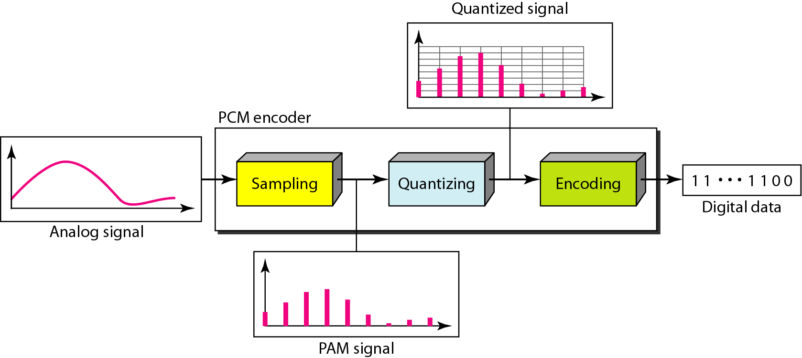
Concept of PCM encoder

Slide 8
Sampling
Analog signal is sampled every T_{S} secs.
T_{s} is referred to as the sampling interval.
f_{s} = 1/T_{s} is called the sampling rate or sampling frequency.
There are 3 sampling methods:
Ideal - an impulse at each sampling instant
Natural - a pulse of short width with varying amplitude
Flattop - sample and hold, like natural but with single amplitude value
The process is referred to as pulse amplitude modulation PAM and the outcome is a signal with analog (non integer) values

Slide 9
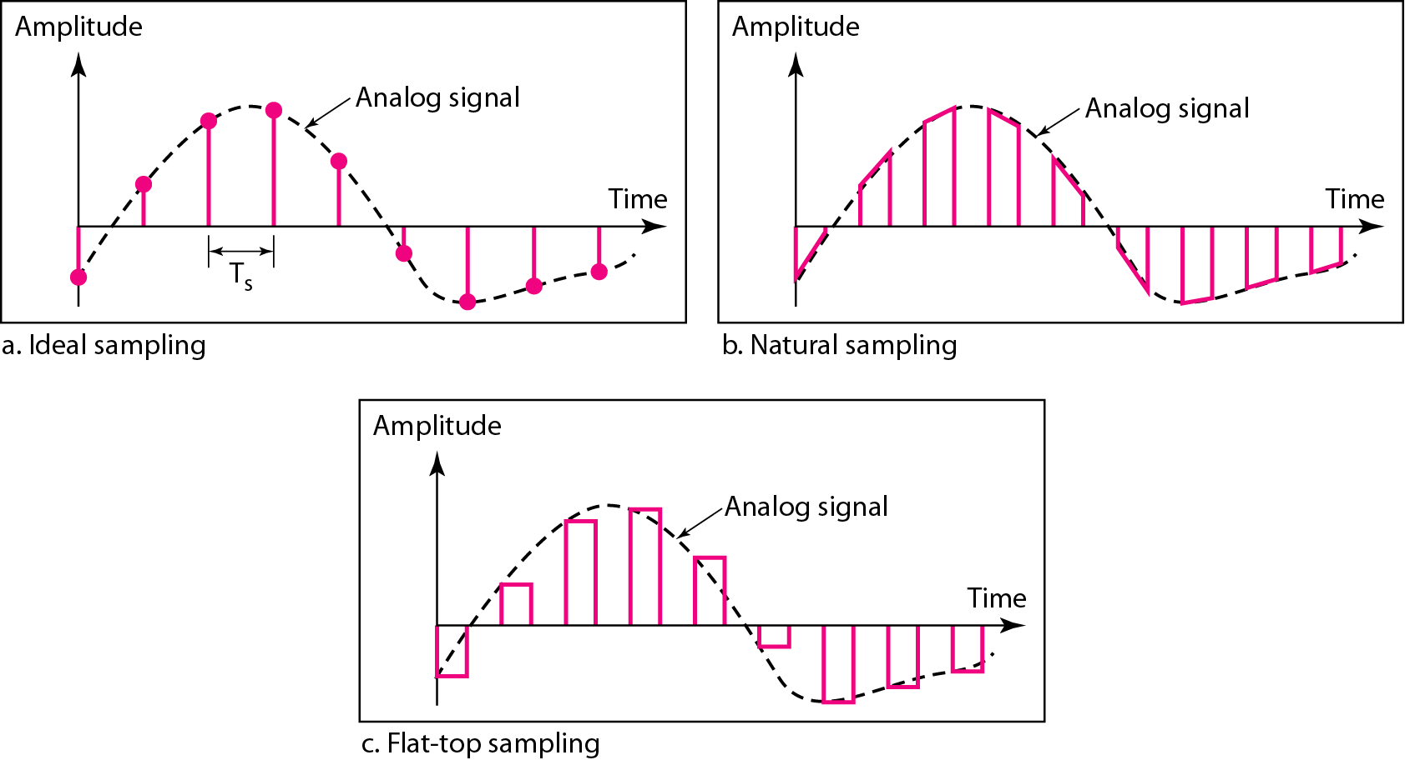
Types of Sampling

Slide 10
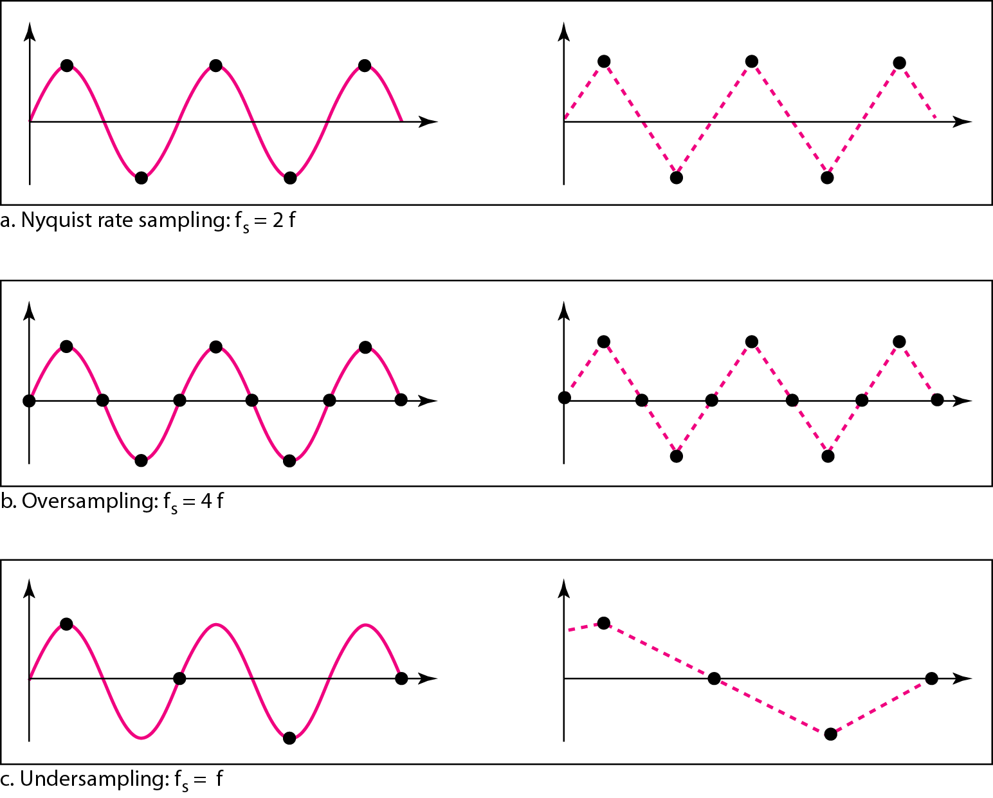
Recovery of a sampled sine wave for different sampling rates

Slide 11
Quantization
Sampling results in a series of pulses of varying amplitude values ranging between two limits: a min and a max.
The amplitude values are infinite between the two limits.
We need to map the infinite amplitude values onto a finite set of known values.
This is achieved by dividing the distance between min and max into L zones, each of height Δ.
Δ = (max - min)/L

Slide 12
PCM Decoder
To recover an analog signal from a digitized signal we follow the following steps:
We use a hold circuit that holds the amplitude value of a pulse till the next pulse arrives.
We pass this signal through a low pass filter with a cutoff frequency that is equal to the highest frequency in the pre-sampled signal.
The higher the value of L, the less distorted a signal is recovered.

Slide 13
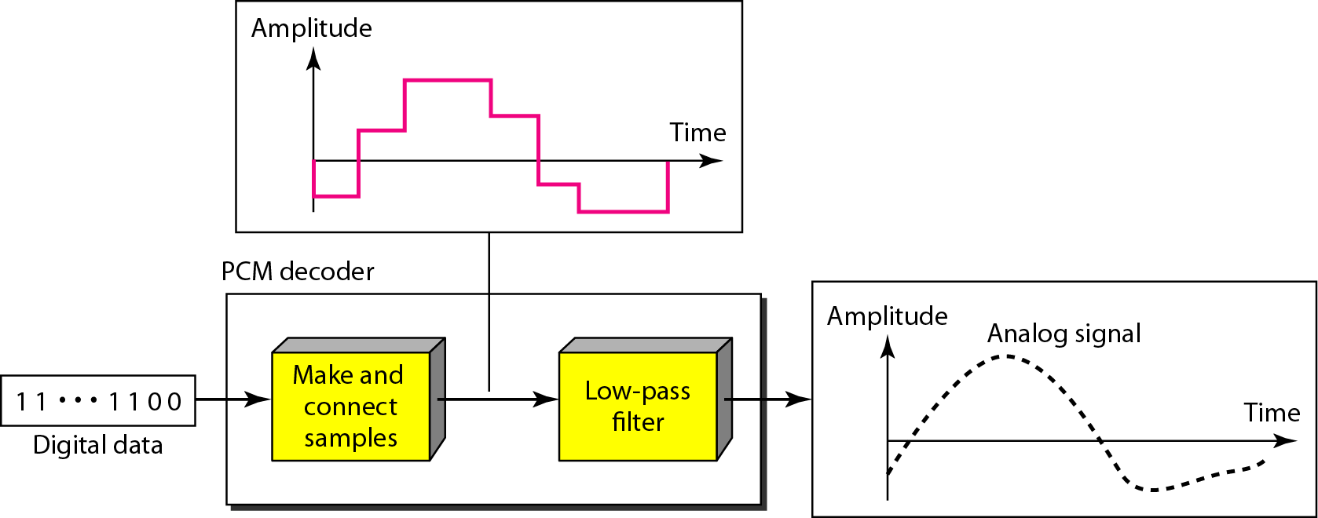
Components of a PCM decoder

Slide 14
Bit rate and bandwidth requirements of PCM
The bit rate of a PCM signal can be calculated form the number of bits per sample x the sampling rate
Bit rate = n_{b} x f_{s}
The bandwidth required to transmit this signal depends on the type of line encoding used. Refer to previous section for discussion and formulas.
A digitized signal will always need more bandwidth than the original analog signal. Price we pay for robustness and other features of digital transmission.

Slide 15
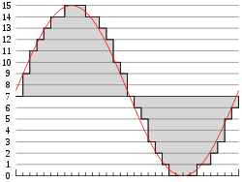
Moulation Of Pcm
In the diagram, a sine wave (red curve) is sampled and quantized for pulse code modulation. The sine wave is sampled at regular intervals, shown as ticks on the x-axis. For each sample, one of the available values (ticks on the y-axis) is chosen by some algorithm. This produces a fully discrete representation of the input signal (shaded area) that can be easily encoded as digital data for storage or manipulation. For the sine wave example at right, we can verify that the quantized values at the sampling moments are 7, 9, 11, 12, 13, 14, 14, 15, 15, 15, 14, etc. Encoding these values as binary numbers would result in the following set of nibbles: 0111 (2³×0+2²×1+2¹×1+2⁰×1=0+4+2+1=7), 1001, 1011, 1100, 1101, 1110, 1110, 1111, 1111, 1111, 1110, etc. These digital values could then be further processed or analyzed by a digital signal processor. Several PCM streams could also be multiplexed into a larger aggregate data stream, generally for transmission of multiple streams over a single physical link. One technique is called time-division multiplexing (TDM) and is widely used, notably in the modern public telephone system.
The PCM process is commonly implemented on a single integrated circuit and is generally referred to as an analog-to-digital converter (ADC).

Slide 16
Demodulation
To produce output from the sampled data, the procedure of modulation is applied in reverse. After each sampling period has passed, the next value is read and the output signal is shifted to the new value. As a result of these transitions, the signal will have a significant amount of high-frequency energy. To smooth out the signal and remove these undesirable aliasing frequencies, the signal is passed through analog filters that suppress energy outside the expected frequency range (that is, greater than the Nyquist frequency ).^{[note 1]} The sampling theorem suggests that practical PCM devices, provided a sampling frequency that is sufficiently greater than that of the input signal, can operate without introducing significant distortions within their designed frequency bands.
The electronics involved in producing an accurate analog signal from the discrete data are similar to those used for generating the digital signal. These devices are Digital-to-analog converters (DACs), and operate similarly to ADCs. They produce on their output a voltage or current (depending on type) that represents the value presented on their digital inputs. This output would then generally be filtered and amplified for use.

Slide 17
Limitation
There are potential sources of impairment implicit in any PCM system:
Choosing a discrete value near the analog signal for each sample leads to quantization error.^{[note 2]}
Between samples no measurement of the signal is made; the sampling theorem guarantees non-ambiguous representation and recovery of the signal only if it has no energy at frequency f_{s}/2 or higher (one half the sampling frequency, known as theNyquist frequency); higher frequencies will generally not be correctly represented or recovered.
As samples are dependent on time, an accurate clock is required for accurate reproduction. If either the encoding or decoding clock is not stable, its frequency drift will directly affect the output quality of the device

Slide 18
Delta Modulation

Slide 19
Introduction
This scheme sends only the difference between pulses, if the pulse at time t_{n+1} is higher in amplitude value than the pulse at time t_{n}, then a single bit, say a “1”, is used to indicate the positive value.
If the pulse is lower in value, resulting in a negative value, a “0” is used.
This scheme works well for small changes in signal values between samples.
If changes in amplitude are large, this will result in large errors.

Slide 20
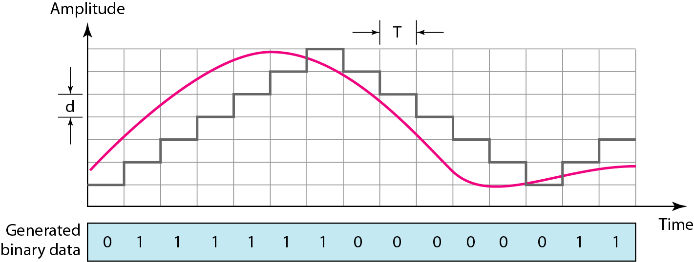
Process of delta modulation

Slide 21
Delta modulation component

Slide 22
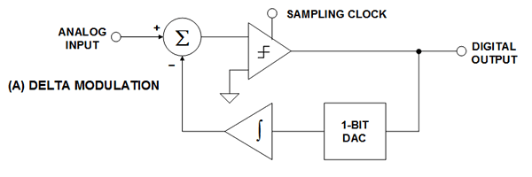
Block diagram of DM

Slide 23
Delta demodulation component

Slide 24
Next form of pulse modulation the delta modulation
Transmits information only to indicate whether the analog signal that is being encoded goes up or goes down
The Encoder Outputs are highs or lows that “instruct” whether to go up or down, respectively
DM takes advantage of the fact that voice signals do not change abruptly
The analog signal is quantized by a one-bit ADC (a comparator implemented as a comparator)
The comparator output is converted back to an analog signal with a 1-bit DAC, and subtracted from the input after passing through an integrator
The shape of the analog signal is transmitted as follows: a "1" indicates that a positive excursion has occurred since the last sample, and a "0" indicates that a negative excursion has occurred since the last sample.

Slide 25
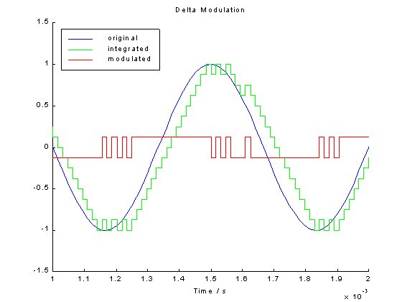
Waveform

Slide 26
Signal Encoding
Digital to Digital
unipolar, polar, bipolar.
Analog to Analog
Amplitude Modulation, Frequency Modulation, Phase Modulation
Analog to Digital
Pulse Code Modulation
Digital to Analog
ASK, FSK, PSK, QAM

Slide 27
Basic Encoding Techniques
Digital data to analog signal
Amplitude-shift keying (ASK)
Amplitude difference of carrier frequency
Frequency-shift keying (FSK)
Frequency difference near carrier frequency
Phase-shift keying (PSK)
Phase of carrier signal shifted
Quadrature Amplitude Modulation (QAM).

Slide 28
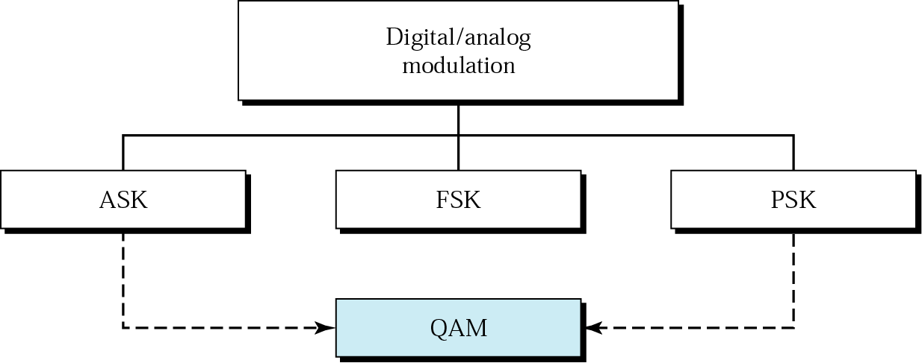
Hierarchy
Types of digital-to-analog modulation

Slide 29
Amplitude-Shift Keying
One binary digit represented by presence of carrier, at constant amplitude
Other binary digit represented by absence of carrier
where the carrier signal is Acos(2πf_{c}t)

Slide 30
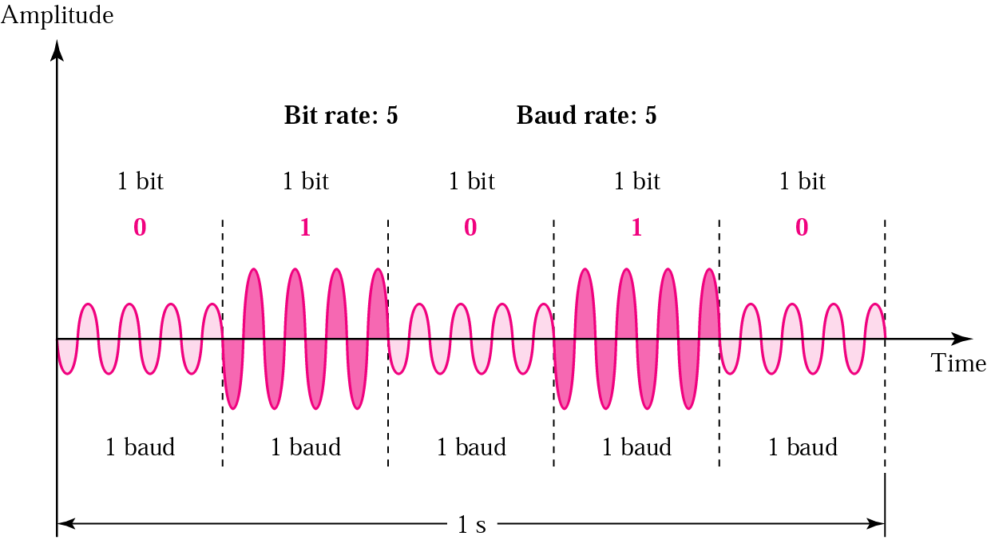
Digital to Analog Modulation
Amplitude Shift Keying (ASK)
the strength of the carrier signal is varied to represent binary 0 or 1
Both frequency and phase remain constant while amplitude changes
The peak amplitude of the signal during each bit duration is constant
ASK transmission is highly susceptible to noise interference

Slide 31
Amplitude Shift Keying (ASK) (contd.)
Bandwidth for ASK
Nbaud: the baud rate
d: the factor related to the modulation process (with a minimum value of 0)

Slide 32
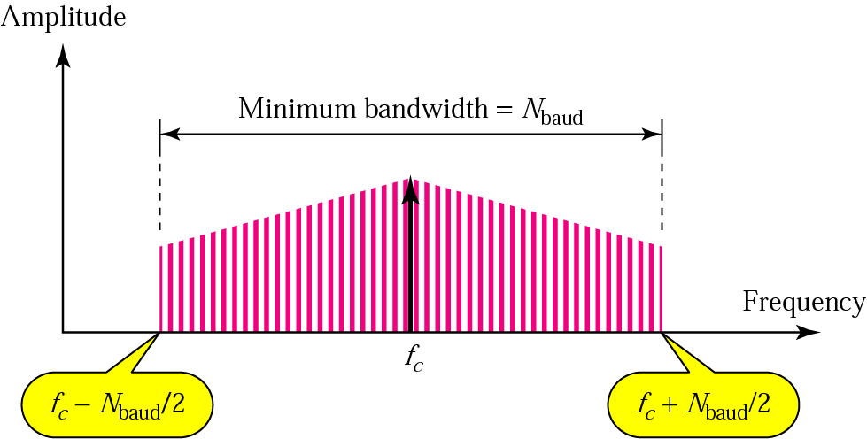

Slide 33
Amplitude-Shift Keying
Susceptible to sudden gain changes
Inefficient modulation technique
On voice-grade lines, used up to 1200 bps
Used to transmit digital data over optical fiber

Slide 34
Amplitude Shift Keying (ASK) (contd.)
A popular ASK technique is called on/off keying (OOK)
One of the bit value is represented by no voltage
(+) reducing total required transmission energy

Slide 35
Binary Frequency-Shift Keying (BFSK)
Two binary digits represented by two different frequencies near the carrier frequency
where f₁ and f₂ are offset from carrier frequency f_{c} by equal but opposite amounts

Slide 36
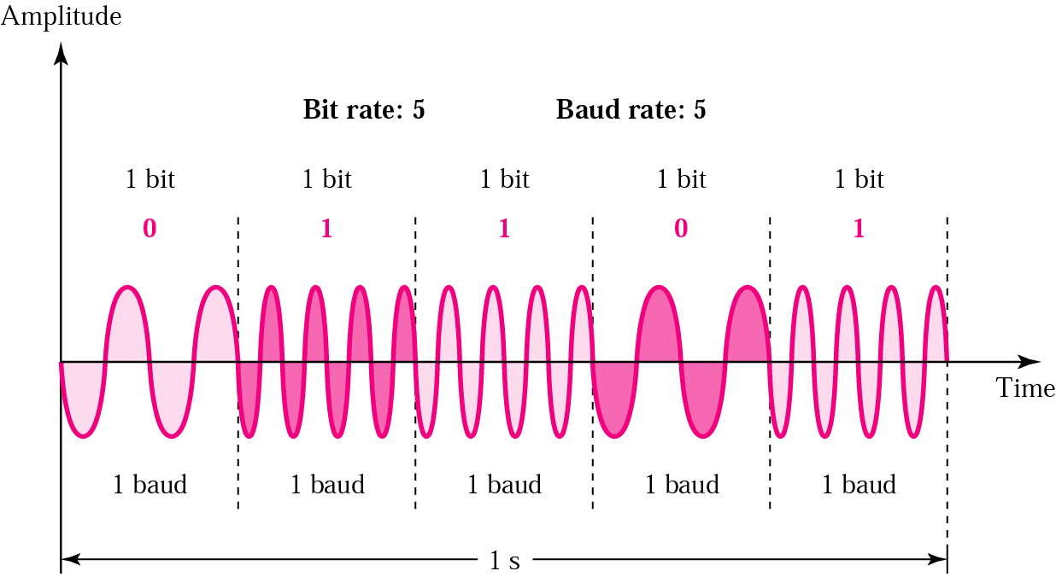
Frequency Shift Keying (FSK)
The frequency of the carrier signal is varied to represent binary 1 or 0
Both peak amplitude and phase remain constant

Slide 37
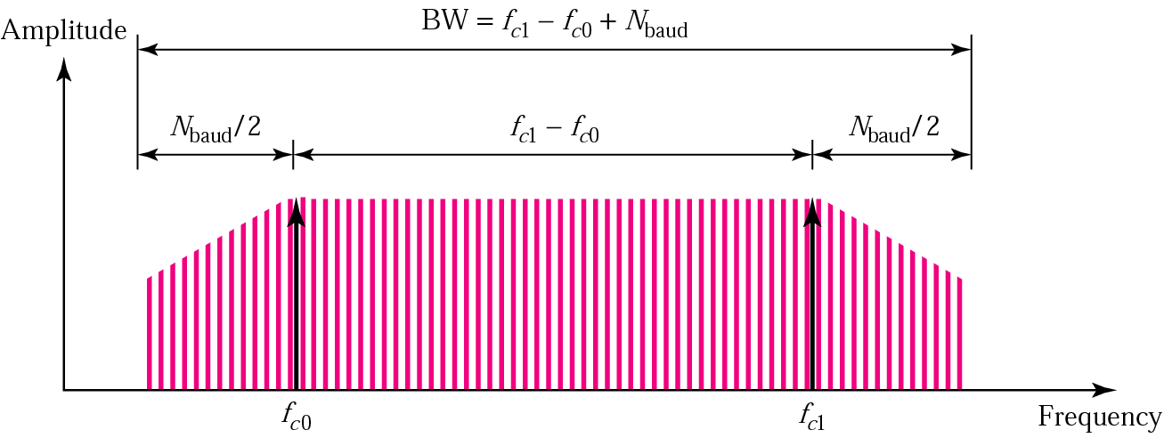
Frequency Shift Keying (FSK) (contd.)
(+) avoiding most of the problems from noise
(−) the limiting factors are the physical capabilities of the carrier
Bandwidth for FSK
BW=f_{c1}− f_{c0}+ Nbaud

Slide 38
Binary Frequency-Shift Keying (BFSK)
Less susceptible to error than ASK
On voice-grade lines, used up to 1200bps
Used for high-frequency (3 to 30 MHz) radio transmission
Can be used at higher frequencies on LANs that use coaxial cable

Slide 39
Phase-Shift Keying (PSK)
Two-level PSK (BPSK)
Uses two phases to represent binary digits

Slide 40
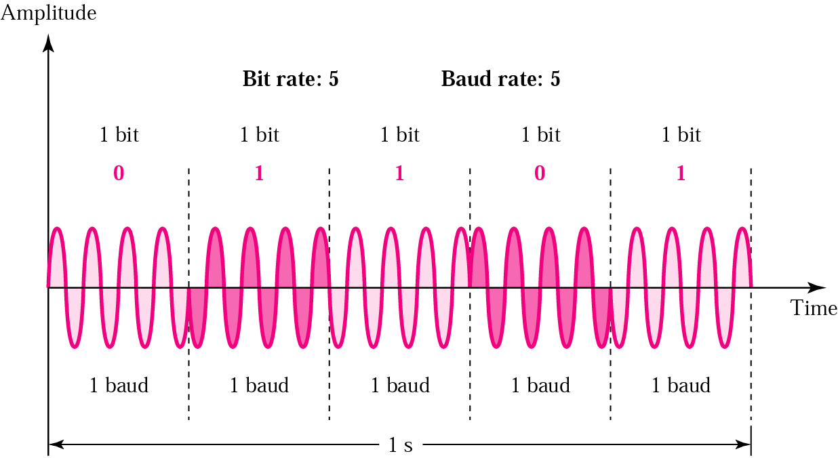
Phase Shift Keying (PSK)
The phase of the carrier is varied to represent binary 1 or 0
Both amplitude and frequency remain constant
Also called 2-PSK or binary PSK (only o⁰ and 180⁰)

Slide 41
Phase Shift Keying (PSK) (contd.)
Constellation
(+) not susceptible to the noise degradation that affects ASK
(+) not susceptible to the bandwidth limitation that affects FSK

Slide 42
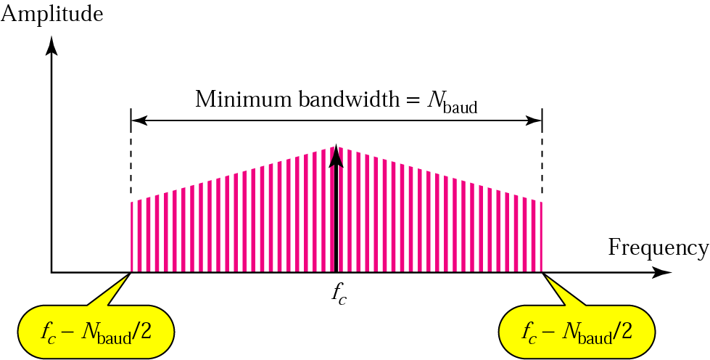
Phase Shift Keying (PSK) (contd.)
Bandwidth for PSK
The minimum bandwidth required for PSK transmission is the same as that required for ASK transmission
PSK and ASK have the same baud rate
PSK has higher bit rate than ASK

Slide 43
Phase-Shift Keying (PSK)
Four-level PSK (QPSK)
Each element represents more than one bit

Slide 44
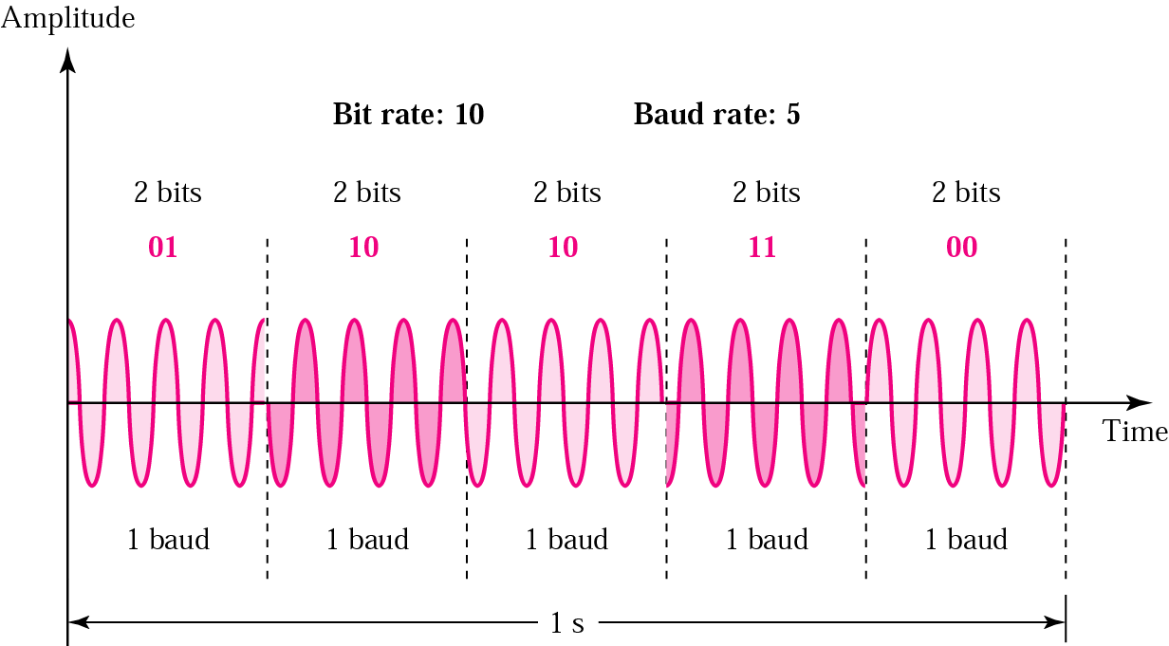
4-PSK
Also known as Q-PSK
Dibit: the pair of bits represented by each phase
Twice transmission rate, compared to 2-PSK

Slide 45
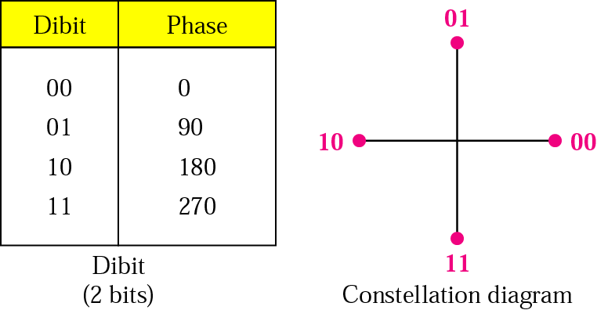
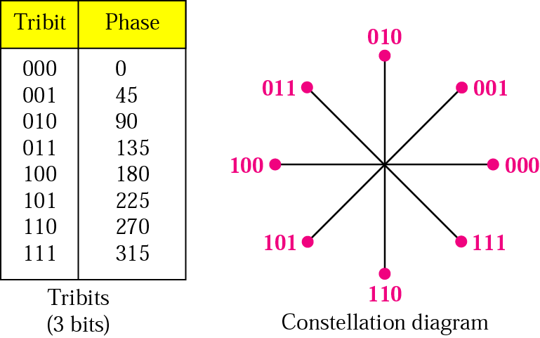
Digital to Analog Modulation
Phase Shift Keying (PSK) The following figure shows clearly the relationship of phase to bit value
2-PSK constellation
4-PSK constellation
8-PSK constellation

Slide 46
Quadrature Amplitude Modulation (QAM)
Why QAM?
PSK is limited by the capability of the equipment to distinguish small differences in phase
Thus limit its potential bit rate
QAM is a combination of ASK and PSK
In general, the number of amplitude shifts is fewer than the number of phase shifts

Slide 47
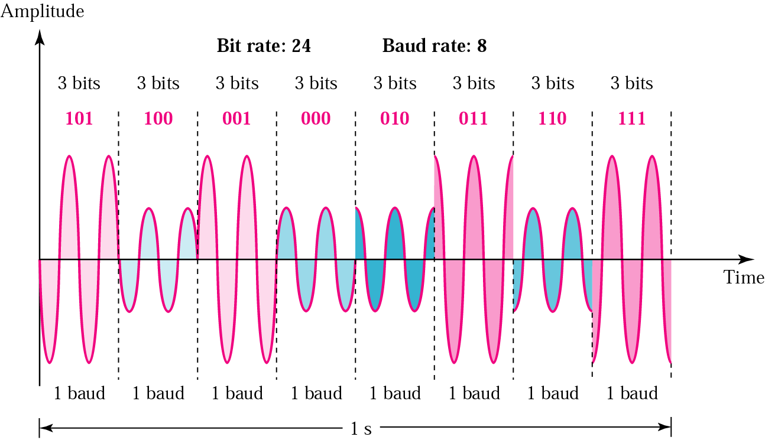
Quadrature Amplitude Modulation (QAM) (contd.)
Figure 5.15 Time domain for an 8-QAM signal

Slide 48
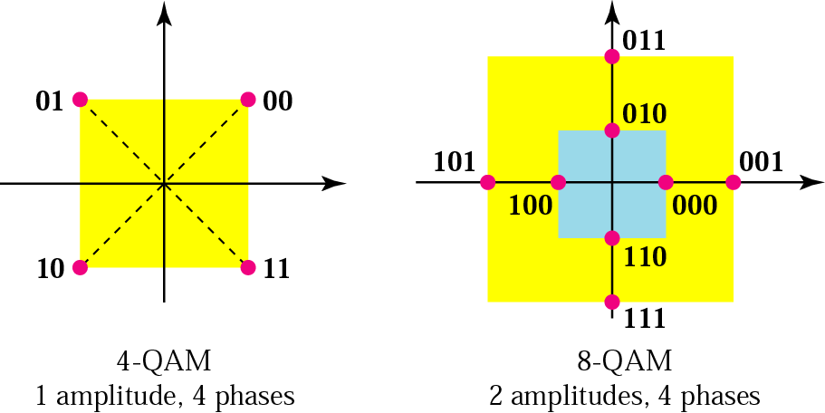
Quadrature Amplitude Modulation (QAM) (contd.)
Figure 5.14 The 4-QAM and 8-QAM constellations

Slide 49
Quadrature Amplitude Modulation
QAM is a combination of ASK and PSK
Two different signals sent simultaneously on the same carrier frequency

Slide 50
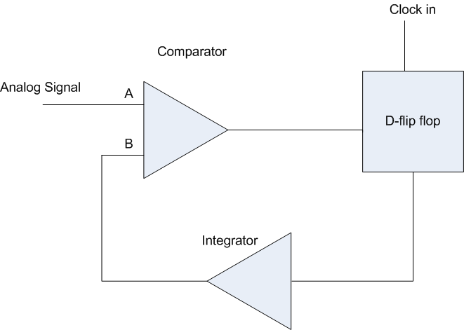
Simple implementation of DM

Slide 51
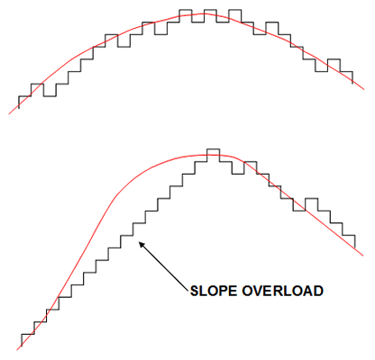
Limitation of Dm
Slope overload
When the analog signal has a high rate of change, the DM can “fall behind” and a distorted output occurs

Slide 52
Thank you

